Slide 1
http://www.vidyanidhi.com/
ketkiacharya.net@gmail.com
Ketki Acharya
From: SM VITA ATC of CDAC
9769201036
ketkiacharya.net@gmail.com

Slide 2
MAP
The Map object is a simple key/value map. Any value (both objects and primitive values) may be used as either a key or a value.
When to use map
Are keys usually unknown until run time, do you need to look them up dynamically?
Do all values have the same type, and can be used interchangeably?
Do you need keys that aren't strings?
Are key-value pairs often added or removed?
Do you have an arbitrary (easily changing) amount of key-value pairs?
Is the collection iterated?

Slide 3
demo
<script>
"use script"
var myMap = new Map();
myMap.set(0, "zero");
myMap.set(1, "one");
for (var [key, value] of myMap) {
console.log(key + " = " + value);
}
// Will show 2 logs; first with "0 = zero" and second with "1 = one"
for (var key of myMap.keys()) {
console.log(key);
}
// Will show 2 logs; first with "0" and second with "1"
for (var value of myMap.values()) {
console.log(value);
}
// Will show 2 logs; first with "zero" and second with "one"
for (var [key, value] of myMap.entries()) {
console.log(key + " = " + value);
}
// Will show 2 logs; first with "0 = zero" and second with "1 = one"
myMap.forEach(function(value, key) {
console.log(key + " =44 " + value);
}, myMap)
</script>
new Map();
0, "zero“
1, "one"
set(0, "zero");
myMap
0 | 1
Zero | one
0 | 1
Zero | one

Slide 4
set
new Set([iterable]);
Set objects are collections of values, you can iterate its elements in insertion order.
A value in the Set may only occur once;
it is unique in the Set's collection.

Slide 5
mySet.delete(5); // removes 5 from the set
mySet.has(5); // false, 5 has been removed
mySet.size; // 4, we just removed one value
for (let item of mySet)
console.log(item);
// logs the items in the order: 1, "some text"
for (let item of mySet.keys()) console.log(item);
// logs the items in the order: 1, "some text"
for (let item of mySet.values()) console.log(item);
// Alternative (with Array.from)
var myarray = Array.from(mySet); // [1, "some text"]
console.log(myarray);
</script>
<script>
"use strict"
var mySet = new Set();
mySet.add(1);
mySet.add(5);
mySet.add("1");
mySet.add("some text");
var o = {a: 1, b: 2};
mySet.add(o);
mySet.has(1); // true
mySet.has(3); // false, 3 has not been added to the set
mySet.has(5); // true
mySet.has(Math.sqrt(25)); // true
mySet.has("Some Text".toLowerCase()); // true
mySet.has(o); // true
mySet.size; // 5

Slide 6
Why WeakMap and WeakSet
As we know from the JavaScript engine stores a value in memory while it is reachable (and can potentially be used).
let john = { name: "John" };
// the object can be accessed, john is the reference to it
// overwrite the reference
john = null;
// the object will be removed from memory
Usually, properties of an object or elements of an array or another data structure are considered reachable and kept in memory while that data structure is in memory.
For instance, if we put an object into an array, then while the array is alive, the object will be alive as well, even if there are no other references to it.
let john = { name: "John" };
let array = [ john ];
john = null; // overwrite the reference
// the object previously referenced by john is stored inside the array
// therefore it won't be garbage-collected
// we can get it as array[0]

Slide 7
Why not to use MAP
Similar to that, if we use an object as the key in a regular Map, then while the Map exists, that object exists as well. It occupies memory and may not be garbage collected.
For instance:
let john = { name: "John" };
let map = new Map();
map.set(john, "...");
john = null; // overwrite the reference
// john is stored inside the map,
// we can get it by using map.keys()
WeakMap is fundamentally different in this aspect. It doesn’t prevent garbage-collection of key objects.

Slide 8
The first difference between Map and WeakMap
is that keys must be objects, not primitive values:
let weakMap = new WeakMap();
let obj = {};
weakMap.set(obj, "ok");
// works fine (object key)
// can't use a string as the key
weakMap.set("test", "Whoops");
// Error, because "test" is not an object

Slide 9
Now, if we use an object as the key in it, and there are no other references to that object – it will be removed from memory (and from the map) automatically.
let john = { name: "John" };
let weakMap = new WeakMap();
weakMap.set(john, "...");
john = null; // overwrite the reference
// john is removed from memory!
Compare it with the regular Map example above. Now if john only exists as the key of WeakMap – it will be automatically deleted from the map (and memory).

Slide 10
WeakMap does not support iteration and methods keys(), values(), entries(), so there’s no way to get all keys or values from it.
WeakMap has only the following methods:
weakMap.get(key)
weakMap.set(key, value)
weakMap.delete(key)
weakMap.has(key)
Why such a limitation? That’s for technical reasons. If an object has lost all other references (like john in the code above), then it is to be garbage-collected automatically. But technically it’s not exactly specified when the cleanup happens.
The JavaScript engine decides that. It may choose to perform the memory cleanup immediately or to wait and do the cleaning later when more deletions happen. So, technically, the current element count of a WeakMap is not known. The engine may have cleaned it up or not, or did it partially. For that reason, methods that access all keys/values are not supported.

Slide 11
Use case: additional data
The main area of application for WeakMap is an additional data storage.
If we’re working with an object that “belongs” to another code, maybe even a third-party library, and would like to store some data associated with it, that should only exist while the object is alive – then WeakMap is exactly what’s needed.
We put the data to a WeakMap, using the object as the key, and when the object is garbage collected, that data will automatically disappear as well.
weakMap.set(john, "secret documents");
// if john dies, secret documents will be destroyed automatically
Let’s look at an example.
For instance, we have code that keeps a visit count for users. The information is stored in a map: a user object is the key and the visit count is the value. When a user leaves (its object gets garbage collected), we don’t want to store their visit count anymore.
Here’s an example of a counting function with Map:
// 📁 visitsCount.js
let visitsCountMap = new Map(); // map: user => visits count
// increase the visits count
function countUser(user) {
let count = visitsCountMap.get(user) || 0;
visitsCountMap.set(user, count + 1);
}

Slide 12
And here’s another part of the code, maybe another file using it:
// 📁 main.js
let john = { name: "John" };
countUser(john); // count his visits
// later john leaves us
john = null;
Now, john object should be garbage collected, but remains in memory, as it’s a key in visitsCountMap.
We need to clean visitsCountMap when we remove users, otherwise it will grow in memory indefinitely. Such cleaning can become a tedious task in complex architectures.
We can avoid it by switching to WeakMap instead:
// 📁 visitsCount.js
let visitsCountMap = new WeakMap(); // weakmap: user => visits count
// increase the visits count
function countUser(user) {
let count = visitsCountMap.get(user) || 0;
visitsCountMap.set(user, count + 1);
}
Now we don’t have to clean visitsCountMap. After john object becomes unreachable, by all means except as a key of WeakMap, it gets removed from memory, along with the information by that key from WeakMap.

Slide 13
Use case: caching
Another common example is caching. We can store (“cache”) results from a function, so that future calls on the same object can reuse it.

Slide 14
// 📁 cache.js
let cache = new Map();
// calculate and remember the result
function process(obj) {
if (!cache.has(obj)) {
let result = /* calculations of the result for */ obj;
cache.set(obj, result);
}
return cache.get(obj);
}
// Now we use process() in another file:
// 📁 main.js
let obj = {/* let's say we have an object */};
let result1 = process(obj); // calculated
// ...later, from another place of the code...
let result2 = process(obj); // remembered result taken from cache
// ...later, when the object is not needed any more:
obj = null;
alert(cache.size); // 1 (Ouch! The object is still in cache, taking memory!)

Slide 15
For multiple calls of process(obj) with the same object, it only calculates the result the first time, and then just takes it from cache. The downside is that we need to clean cache when the object is not needed any more.
If we replace Map with WeakMap, then this problem disappears. The cached result will be removed from memory automatically after the object gets garbage collected.
// 📁 main.js
let obj = {/* some object */};
let result1 = process(obj);
let result2 = process(obj);
// ...later, when the object is not needed any more:
obj = null;
// Can't get cache.size, as it's a WeakMap,
// but it's 0 or soon be 0
// When obj gets garbage collected, cached data will be removed as well
// 📁 cache.js
let cache = new WeakMap();
// calculate and remember the result
function process(obj) {
if (!cache.has(obj)) {
let result = /* calculate the result for */ obj;
cache.set(obj, result);
}
return cache.get(obj);
}

Slide 16
WeakSet
WeakSet behaves similarly:
It is analogous to Set, but we may only add objects to WeakSet (not primitives).
An object exists in the set while it is reachable from somewhere else.
Like Set, it supports add, has and delete, but not size, keys() and no iterations.
Being “weak”, it also serves as additional storage. But not for arbitrary data, rather for “yes/no” facts. A membership in WeakSet may mean something about the object.
For instance, we can add users to WeakSet to keep track of those who visited our site:

Slide 17
let visitedSet = new WeakSet();
let john = { name: "John" };
let pete = { name: "Pete" };
let mary = { name: "Mary" };
visitedSet.add(john); // John visited us
visitedSet.add(pete); // Then Pete
visitedSet.add(john); // John again
// visitedSet has 2 users now
// check if John visited?
alert(visitedSet.has(john)); // true
// check if Mary visited?
alert(visitedSet.has(mary)); // false
john = null;
// visitedSet will be cleaned automatically
The most notable limitation of WeakMap and WeakSet is the absence of iterations, and the inability to get all current content. That may appear inconvenient, but does not prevent WeakMap/WeakSet from doing their main job – be an “additional” storage of data for objects which are stored/managed at another place.

Slide 18
WeakMap is Map-like collection that allows only objects as keys and removes them together with associated value once they become inaccessible by other means.
WeakSet is Set-like collection that stores only objects and removes them once they become inaccessible by other means.
Their main advantages are that they have weak reference to objects, so they can easily be removed by garbage collector.
That comes at the cost of not having support for clear, size, keys, values…
WeakMap and WeakSet are used as “secondary” data structures in addition to the “primary” object storage. Once the object is removed from the primary storage, if it is only found as the key of WeakMap or in a WeakSet, it will be cleaned up automatically.

Slide 19
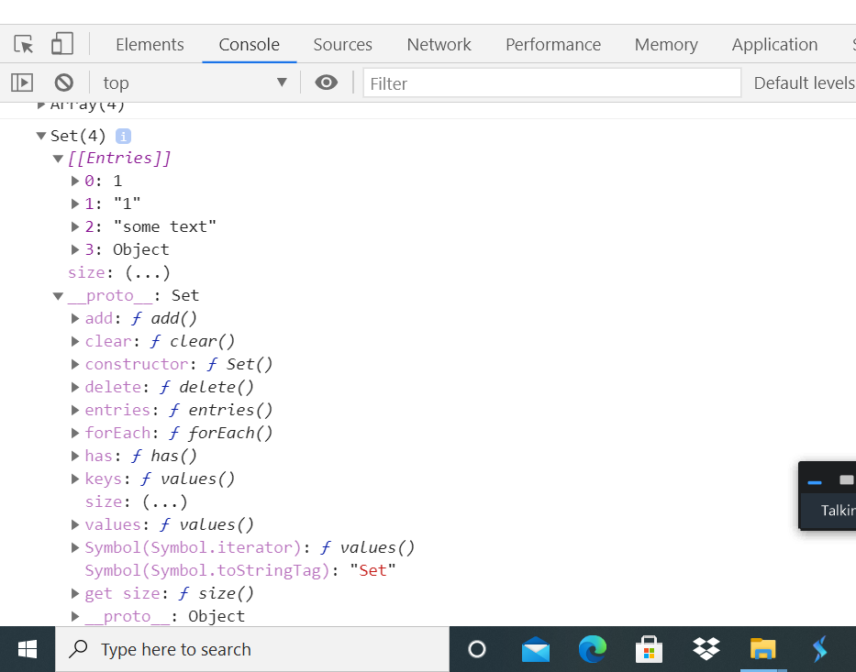
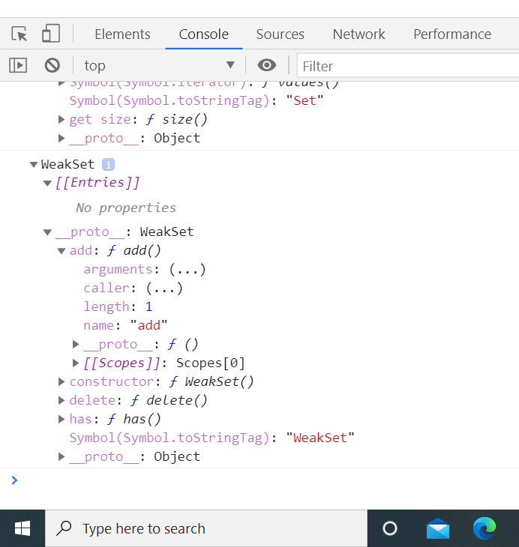
Set
WeakSet

